Slide 1
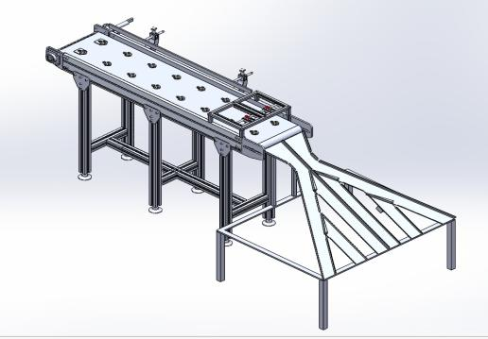
Welcome

Slide 2
Dedicated Job Thickness Measurement Automation
Project Analysis, Research-work And Conclusion
Team Members :
Group No : 5
1. Tejas Anil Patil
2. Kirtikumar Kishor Kadam
3. Jeevan Dipak Ahire
4. Pawan Bharat Jaware
Group No : 4
1. Sujit Bhausaheb Jamdade
2. Komal Sandip Deshmukh
3. Aniket Yashwant Kedari 4. Chetan Jalinder Gaikwad

Slide 3
Content
Introduction Objectives
Scope
Problem Statement
Industrial Current Method of Inspection
Methodology
Concept Block Diagram
Idea of work
Manufacturing of Setup
Sensor Selection Approach
Trials and Validation
Project Images
Conclusion

Slide 4
Introduction
In today’s fast-moving, highly competitive industrial world, a company must be flexible, cost effective and efficient if it wishes to survive. In the process and manufacturing industries, this has resulted in a great demand for industrial control systems/ automation in order to streamline operations in terms of speed, accuracy, reliability and production output.

Slide 5
WHAT IS AUTOMATION?
Automation is the technology by which a process or procedure is performed with minimal human interference through the use of interdisciplinary technologies.
It is the technique of making a process or a system operate automatically without/least amount of human intervention.
Automation crosses all functions within almost every industry from installation, maintenance, manufacturing, marketing, sales, medicine, design, procurement, management, etc.

Slide 6
OBJECTIVES
Design a conveyor for job handling with sensor assembly mounting above it.
Design a slide separator for categorizing jobs into undersized, oversized and okay.
Lesser influence of human factor to technological process
Increasing efficiency and quality while reducing costs
Increase in job thickness gauging process efficiency
Reduced time for inspection and quality control

Slide 7
SCOPE:
Conveyor systems are mechanical devices or assemblies that are used to transport various materials with little effort. There are different kinds of conveyor systems, usually consisting of a frame that supports either wheels, rollers or a belt, upon which the materials move from one place to another. Growth in infrastructure activities such as malls, airports, etc. is also among foremost factors driving growth for conveyor belt market. Conveyor belts are used in several industries spanning logistics, manufacturing, automotive, airports and more.

Slide 8
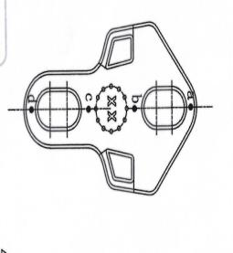
Problem Statement
We have a target to measure thickness of specific job at 4 points as shown in the fig. The criteria is that the thickness of job should be in between 3.11 mm to 3.30 mm. If job thickness is within tolerance then the job is in ok condition, if it exceeds the upper limit then the job is over-sized and requires further machining to satisfy the ok condition, if it is below the lower limit then the job can’t be reworked and is rejected having no use. So the industry want to automate the system.
In this fig, points a, b, c, d are the 4 points where we have to measure thickness.

Slide 9
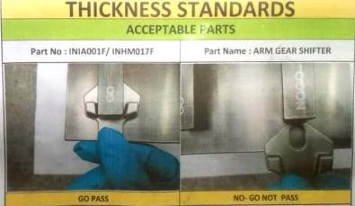
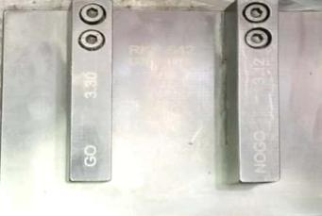
The Method that the Industry follows before Automation
On industry level, accuracy is very important. Due to human involvement, sometimes we don’t get accuracy. They used go and no go gauges for the measurement of thickness of a job. This method takes time for inspection and need human effort.

Slide 10
METHODOLOGY
Job Feeding
Measurement Acquisition
Categorizer Unit
Sorted Components
First the conveyor is designed such that two jobs can be inspected on two dedicated lines/stations at any given time. Based on conveyor dimensions and categories of sorting, separator (Categoriser) is designed and so is sensor assembly. Also a guide-sheet is designed for proper alignment of job under laser beam on conveyor.
The job is fed to the system from one end on the slotting made on guide-sheet which is of job’s shape. It moves on conveyor, gets inspected by sensor and passed onto separator to be sorted. Sorted components are stored in the bins placed at the end of separator.

Slide 11
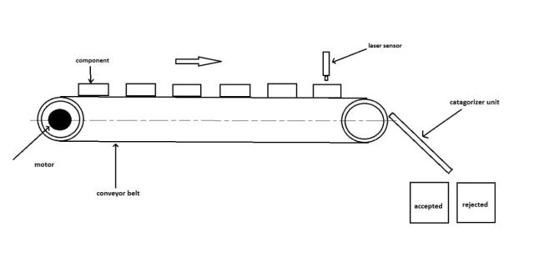
Proposed Concept old Block Diagram
Induction motor

Slide 12
Industry accepted solution :
For this automation project first we design our magnetic conveyor so that highly sensitive sensor is fed with a properly aligned job. A sensor mounting assembly with 2 degree of freedom(horizontal and vertical) is designed. At the end of conveyor a Categorizer unit segregates the job using motors connected to flaps. A setup quite similar to pinball game in windows.
Idea of work :
With the help of manually feeding of job in slot, It will travel with conveyor and passed under the sensor unit then the sensor assembly will automatically inspect the job and gives signal to the motors of Categorizer via a controller and accordingly the appropriate motors rotate in required direction and components goes to the categorized bean through categorized unit.

Slide 13
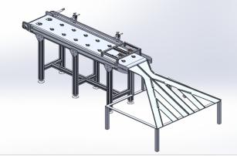
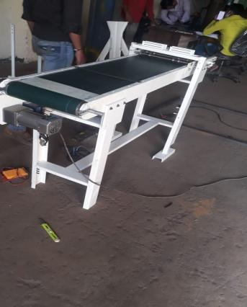
Conveyer Belt
Figure shows the conveyer belt which is used to convey the jobs.
In the earlier approach, the impressions of job shape are made on belt for proper orientation of job along the conveyor length. But this approach didn’t work due to increased belt thickness which would in turn stress out motor and other components of the system leading to failure.
Then we decided to go for magnetic type conveyor that holds the jobs in proper alignment and position due to use of sheet magnets under the belt of conveyor.

Slide 14
Non-contact thickness Measurement
Various sensors and their working principles were studied and research was done advantages and disadvantages of all possible thickness measurement or displacement sensors.
Few sensor approaches were shortlisted and the best one was chosen based on performance factors like accuracy, measuring range, start of measuring, beam diameter, external interference factors.

Slide 15
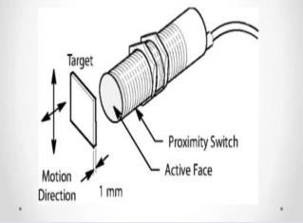
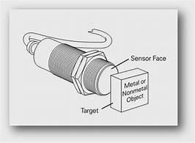
Approach 1
Proximity Displacement Sensor :
Proximity sensor is a sensor able to detect the presence of nearby objects without any physical contact. A proximity sensor often emits an electromagnetic field or a beam of electromagnetic radiation (infrared, for instance), and looks for changes in the field or return signal.

Slide 16
Reason of Rejection of Approach 1
We didn’t get the sensor of required size and also the operating range is not sufficient to suit for our Project
The accuracy is not satisfy the industry requirement
The requirement is not accomplished by the proximity sensor.
Soes not get the stable Reading

Slide 17
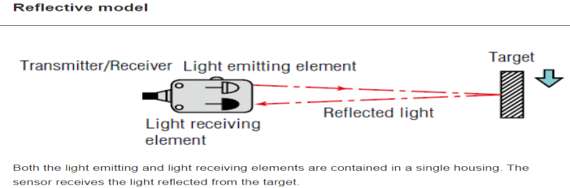
Approach 2
Photoelectric Displacement Sensor :
A photoelectric sensor emits a light beam (visible or infrared) from its light-emitting element.A reflective-type photoelectric sensor is used to detect the light beam reflected from the target.A thrubeam type sensor is used to measure the change in light quantity caused by the target crossing the optical axis. A beam of light is emitted from the light emitting element and is received by the light receiving element.

Slide 18
Reason of Rejection of Approach 2
Highly Expensive
Not suitable with the design as the sensor unable to give accurate reading due to vibration in belt
Affected by light and Pollution

Slide 19
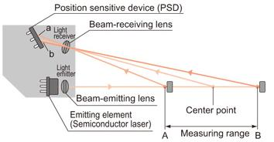
Approach 3
Laser Displacement Sensor :
The principle of laser displacement sensor ranging is a method where triangulation is applied by combining the emitting element and the position sensitive device (PSD) to perform ranging (detecting the amount of displacement). The laser light is focused through the emitting lens and projected on an object. At that time, some of the light beam that is reflected from the object produces a light spot on the position sensing device. When the object moves, the PSD moves as well. Detecting the changes in positions makes it possible to detect the amount of displacement of the object.

Slide 20
Final Approach Selection
The LASER Dispacement sensor is finalized for the thickness measurement.
Reasons for selection of LASER Sensor :
High accuracy in the range of few microns
Smallest beam diameter amongst all dispalcement sensor. Least the beam diameter, higher the accuracy.
High sensitivity
Least Susceptible to external disturbances like vibration .

Slide 21
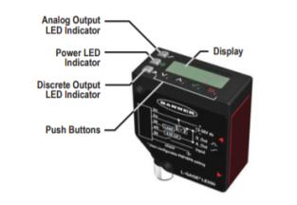
Trials Conducted on different LASER Sensors: 1) Banner Sensor:
1) Banner: Banner industries provided us L-GAGE® LE250/550 Analog-Discrete Laser Sensor for trial purposes.
We installed the sensor on our setup and conducted a few trials, it was observed that the sensor was a bit difficult to install and the reading contained noise.
The minor vibrations in the system translated into large measurement deflections for the sensor. That was not acceptable in our system hence we decided not to use Sensor from banner Industries.

Slide 22
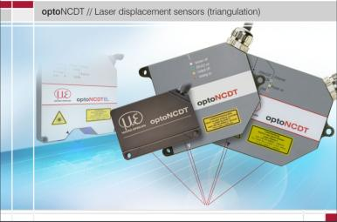
We contacted Micro-epsilon Sensors Pvt. Ltd. via their website and we had a chance to talk with their representative via a zoom meeting for our sensing requirements. The sensor that they provided us for trials was optoNCDT - 1320 sensor, Model No.: ILD1320-10.
2) Micro-Epsilon:

Slide 23
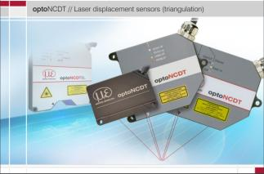
optoNCDT ILD1320-10 Laser displacement sensor Specifications
Measuring range: 10 mm
Start of measuring range: 20 mm
Mid of measuring range : 25 mm
End of measuring range : 30 mm
Linearity: < ±10 µm
Light source: Semiconductor laser < 1 mW, 670 nm (red)
Supply voltage: 11 … 30 VDC
Signal input: < 2 W (24 V)
Analog output: 4 ... 20 mA (12 bit, freely scalable
within the measuring range)
Connection: integrated cable 3 m, open ends, minimum
bending radius 30 mm (fixed installation)
Material: Aluminum housing
Weight: approx. 30 g (without cable),
approx. 145 g (incl. cable)
Control and display elements: Select button: zero, teach, factory setting; Web interface for setup with defined presets 6); 2 x color LEDs for power / status

Slide 24
The Laser optical displacement sensor from Micro-Epsilon was finalized as the way to go about on the basis of following factors : 1. This sensor showed promise as it had a sufficient measuring range and an error compensation feature that can compensate for system vibrations, noise through a component called C-Box. 2. The body vibrations did not affect the measurement values on a large amount and this sensor was finalized. 3. The sensor was easy to connect and install. And the sensor’s body was pretty robust.
4. Highest resolution( in range of few microns )
5. Quickest response time
6. Highest accuracy
7. Least affected by the external interference causing factors.
8. Easy calibration
9. Easy integration with controller
WHY WE SELECTED THE Micro-Epsilon optoNCDT ILD1320-10 SENSOR

Slide 25
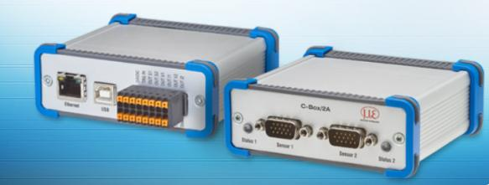
Micro-Epsilon C-Box Controller
C-Box is used for fast D/A conversion of two digital input signals or for evaluating two digital sensor signals. Output of the sensor signals is possible via two configurable analog outputs, Ethernet or USB. Handling of the C-Box/2A and of the connected sensors are performed via web interface. Averaging functions, thickness, diameter, step and inclinations can be calculated. The D/A conversion is executed with 16 Bit and max. 70 kHz.

Slide 26
Micro-Epsilon C-Box Controller Features
A smart accessory for Micro-epsilon sensor doing many tasks.
Can be programmed for error-compensation arising out of fluctuating reference point, system vibrations and external disturbances
Also acts as Analog-to-Digital Convertor(ADC).
Has two digital output ports that gives flexibility to connect sensors to digital controllers
Can be used to programme the sensor based on our needs and also modify certain sensor parameters to suit our needs.
Also acts as an interface between sensor and computer via an ethernet for programming, displaying live-readings.

Slide 27
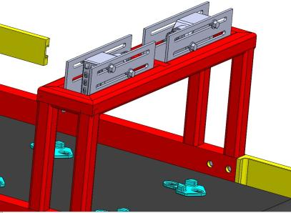
Sensor Assembly
Sensor assembly consists of two sensing stations.
Two pairs of LASER displacement sensors are used .
For every sensing station, one sensor acts as Master and other as slave.
Total two sensing stations for increased inspection rate.
Master-slave arrangement leads to compensation of error arising out of fluctuating reference point on a constantly moving belt surface.
The two sensors at a sensing station to be placed as close as possible.

Slide 28
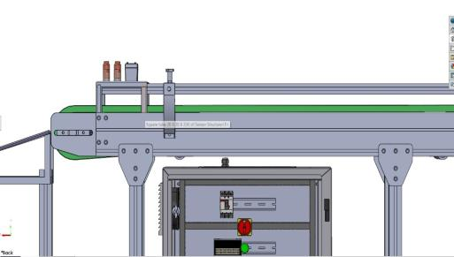
Control Panel
This control panel will contain all the controls of the Sensors, Controllers, conveyor power, speed and motion, emergency stop and other miscellaneous switches.

Slide 29
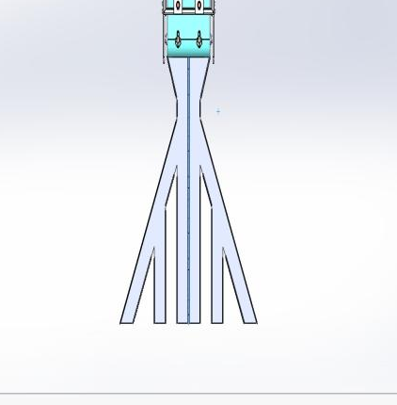
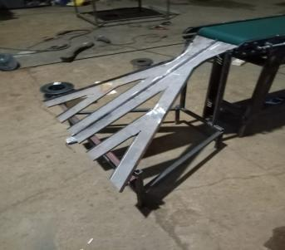
Categorizer Unit
The challenge was to sort the measured job into three categories, named as Ok jobs, UNDERSIZE jobs and OVERSIZE jobs.
We developed the categorizer unit to separate the jobs as shown in figure.
The idea behind the design is the PINBALL Game which comes with the Windows XP Operating System

Slide 30
Working principal of Categorizer Unit
The categorizer unit has four stepper motors located at four path separation points.
The shafts of motors are attached to flaps that operate in clockwise/anticlockwise direction based on sensor output to open different bin paths based on whether job is undersized, okay or oversized.
Stepper motors provide precise angular movement for a precise opening and closing of paths.
At the end of categorizer, there are bins for storage of segregated jobs.
The oversized jobs are then periodically collected and sent for rework.
The okay jobs go for further processing.
The undersized jobs can’t be reworked and are scrapped.

Slide 31
Report by – PMS Robotics Team
We successfully completed this project. This experience is very helpful for us in future. We learned so many things in this project having worked with different new technologies. We applied this knowledge during the working in company. This project is sponsored by PMS robotics. And all the fabrication work is done at the Radical Fabrotech workshop under the Guidance of Mr. Jadhav sir in Talwade MIDC. This project is made for Unique Tools Pvt. Ltd. So the Devendra sir who was technical representative from the Unique tool validated our project to meet their requirement.
We used different sensors for the testing and Mr. Devang Pardeshi sir from Banner helped us for the testing. We took number of trials on this project and finally we obtained desire result which is validated by Mr. Devang and Mr. Mohite.

Slide 32
The following results were obtained from the trial..
Speed of Motor : 70 rpm which is equivalent to 0.22 m/s of linear velocity.
Time taken by worker to Locate Job on alignment fitment : 3 sec
Time Required for Job inspection Under Sensor : 6.81 sec
Time to segregate : 2 sec
Total Time for One Job : 11.81
Job to be inspected in an min : 17
Job to be inspected in an hour : 1196
Job to be inspected in 8 Hours : 9594
Cycle Time : 3.52 sec/job

Slide 33
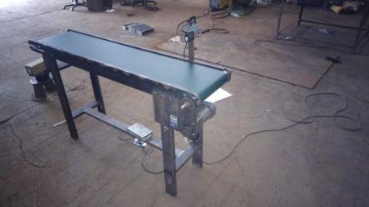
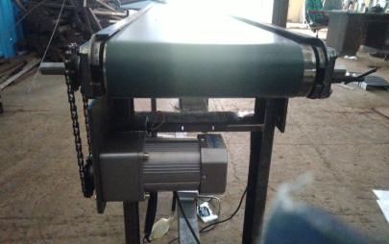
Manufacturing :
Conveyer Belt

Slide 34
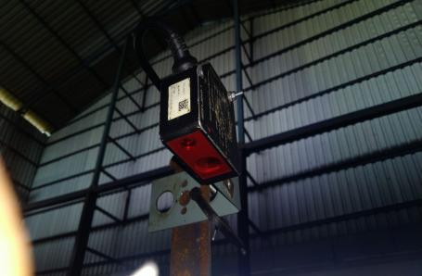
Sensor
Sensor Assembly

Slide 35
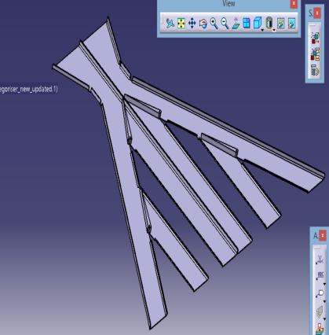
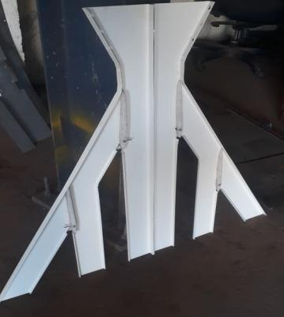
Categorizer

Slide 36
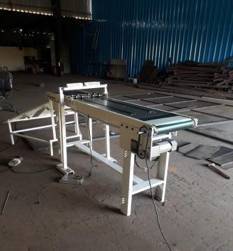
Final Assembly

Slide 37

Industry Person Review
Hello I am Devang and I am executive of micro-epsilon, Because of this project I gave the opportunity to work with Team PMS Robotics. For this project, I visited workshop at that time the conveyor is in fully working condition. My work is to provide a sensor which can fulfil their expectations without any rupture and to give a technical support related to sensor. Luckily sensor which I suggested fit and work as required. I really enjoyed working with this team. I like their enthusiasm towards work and I wish them the best of luck. Thank You.
- - - Mr Devang Pardeshi

Slide 38

Industry Person Review
Hi. My name is Rohit Mohite. I am professional programmer and I guided these students from DYP Akurdi in the programming of this Dedicated Job Thickness Measurement Automation. I tried to analyse the project from Industrial utility perspective and it seems that the project would for certain, help to increase the inspection rate of job for the client.
--- Mr. Rohit Mohite

Slide 39

Industry Person Review
Hello I am Nikhil Jadhav, Owner of Radial Fabrotech. I'm responsible for fabrication of this project . At the time of receiving this project I felt that this is not going to work but I like to take challenges so I decided to work on this project. At the time of actual working these students took multiple responsibilities like designing conveyor, fabrication operations and purchasing material under my guidance.. We encountered many obstacles while doing this project but these students kept on making their way on it. And finally, I can definitely say that my overall experience is very good with this Project. Thank You. I'm happy to guide these students on a very nice project.
- - - Mr. Nikhil Jadhav

Slide 40
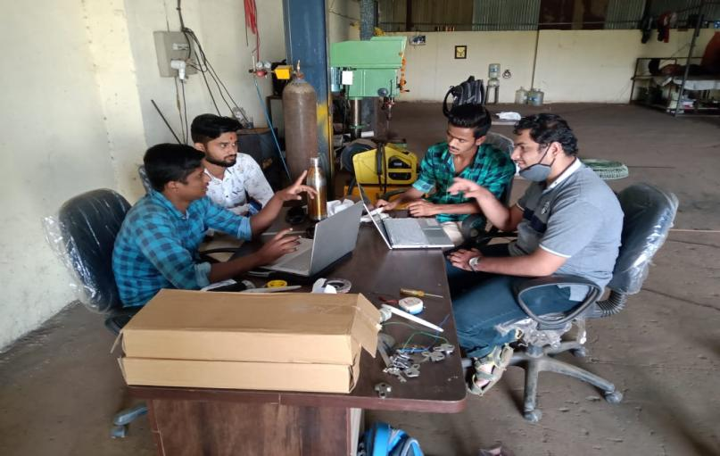

Slide 41
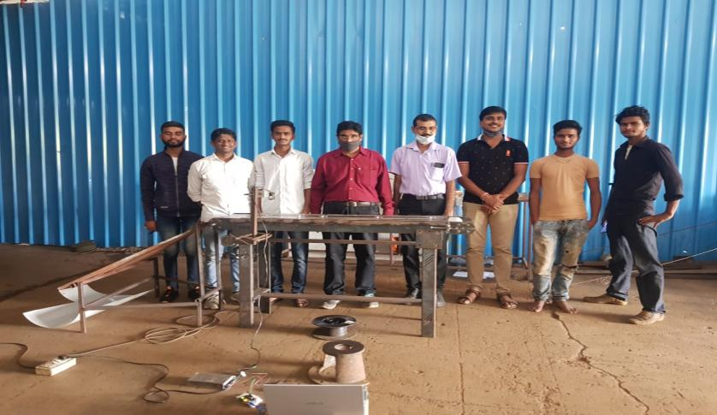

Slide 42
Conclusion
As validated by multiple Industry experts, our project would surely increase the inspection rate of jobs by about 2 times. But due to current Covid-19 pandemic, the industries around the world are experiencing a slump. And Unique Tools Pvt. Ltd. is no exception. Thus currently the production of this particular job has been reduced. So for the time being, Unique Tools plans to start inspection of jobs on only one sensing station out of total two sensing staions using two LASER sensors. As and when the situation relieves, Unique Tools Pvt. Ltd. would release Purchase Order for second set of two LASER sensors to activate second inspection station. The programming for second station would be done then.
Currently single sensing station provides Unique tools with an hourly inpection rate 1196 jobs. That would double when second sensing station becomes active.

Slide 43
Thank You…

